Slide 1
Weboin App Bugs
This app cointains a lot of bugs I have personally handpicked 30 from there

Slide 2
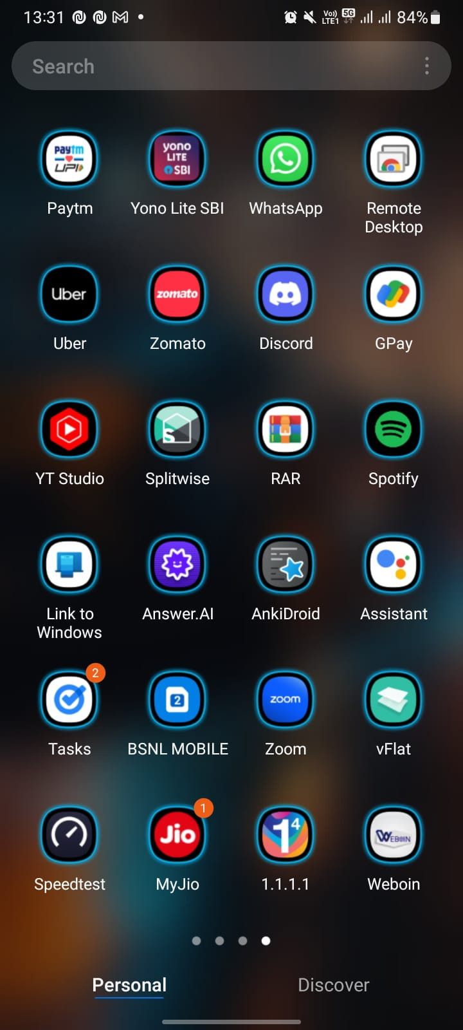
Doesnot show Message notifications
No notifications on App, inspite of receiving a message

Slide 3
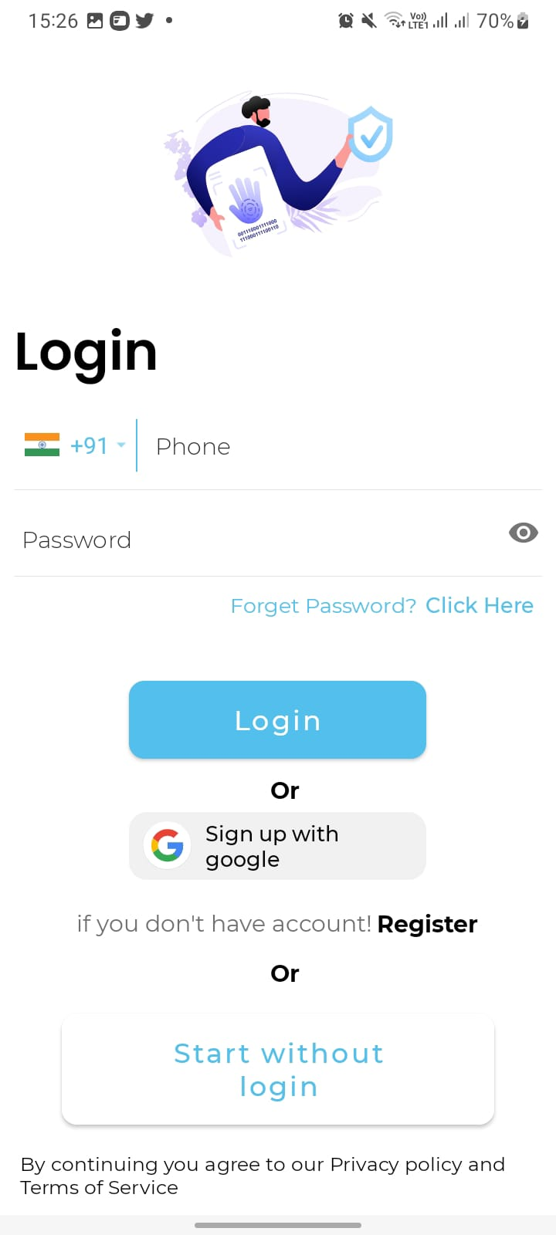
Change 'Forget password' to "Forgot password".
Grammatical error correction necessary

Slide 4
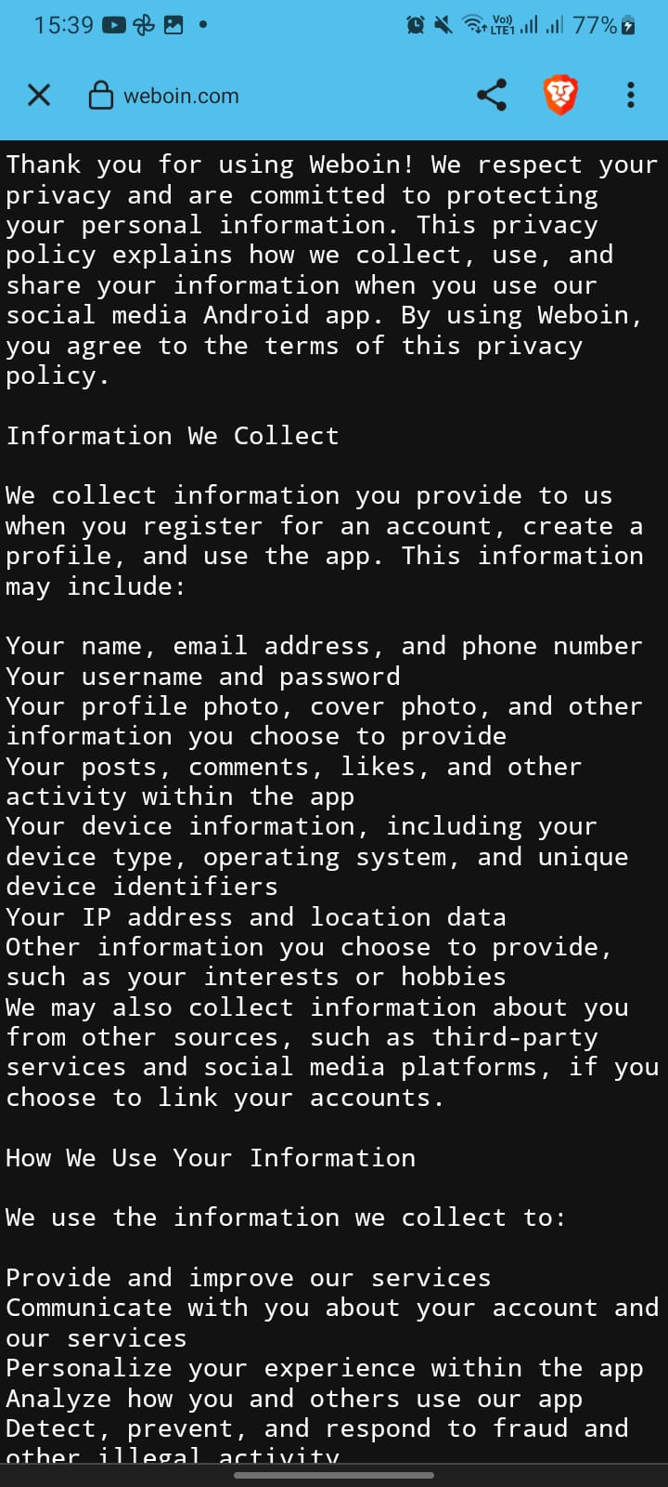
Terms and Service portion should be highlighted
Need good UI/UX for its designing

Slide 5
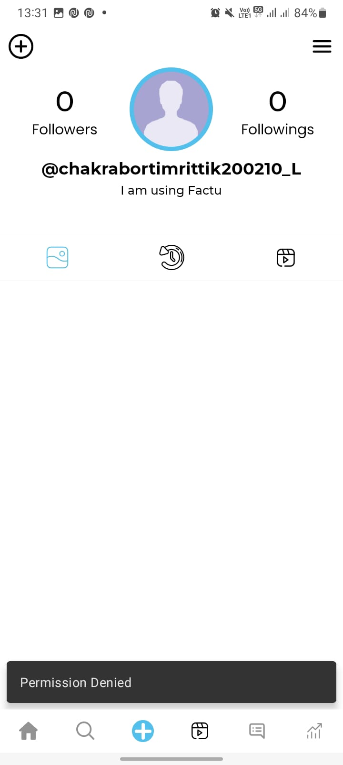
Cannot change profile details
Cannot change profile details neither add anything.

Slide 6
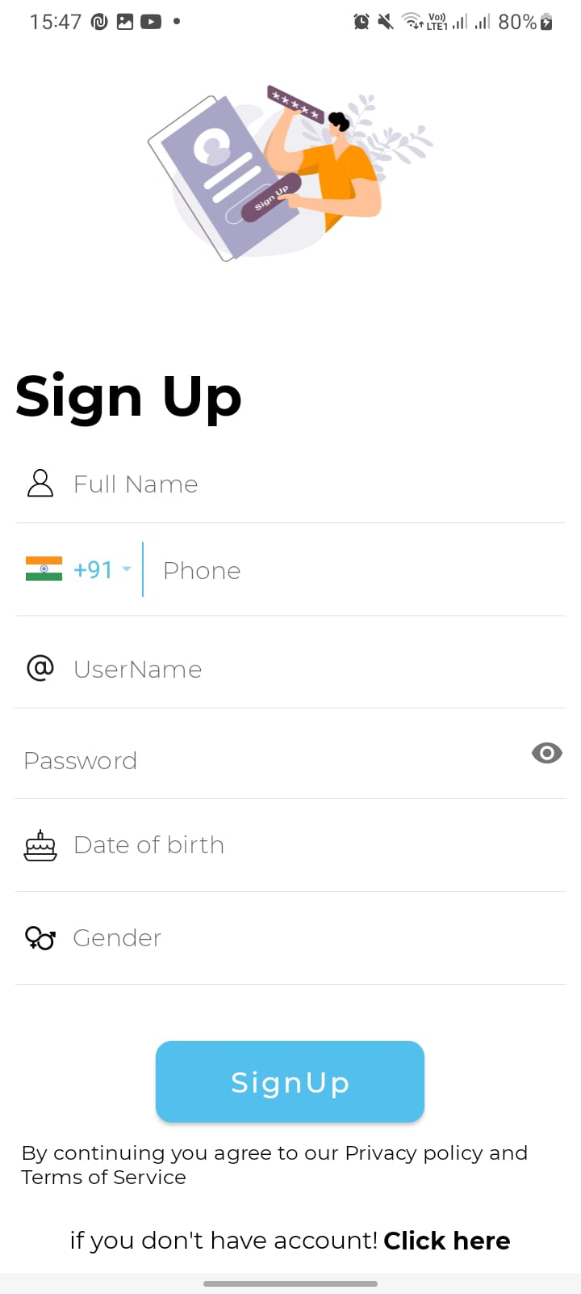
Include email option in signup page
Include Email option for authentication

Slide 7
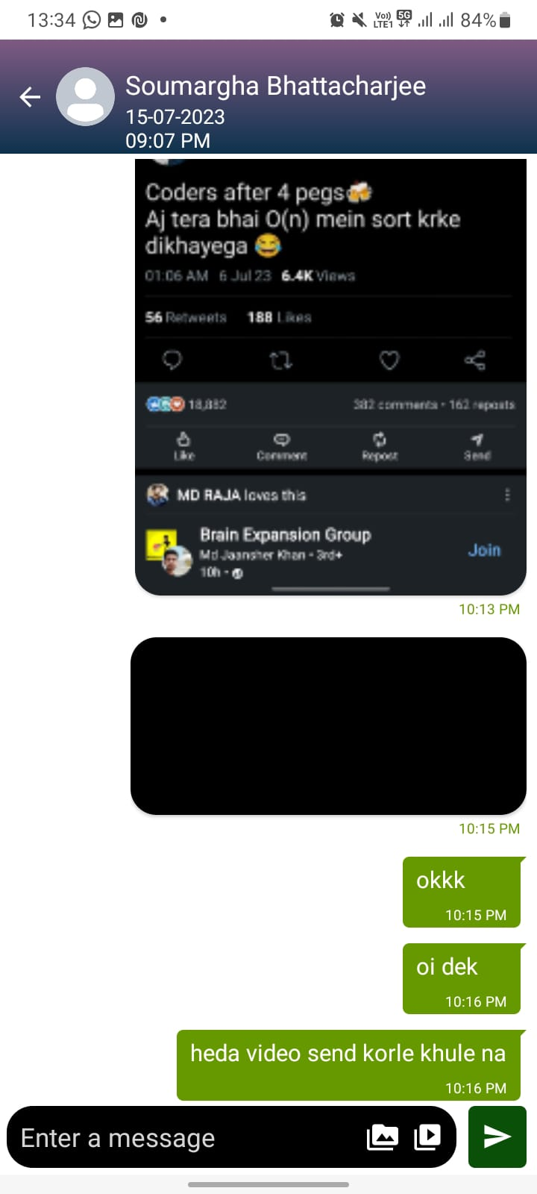
Message interface is unattractive
Need good amount and dedicated working in making the user interface for message attractive

Slide 8
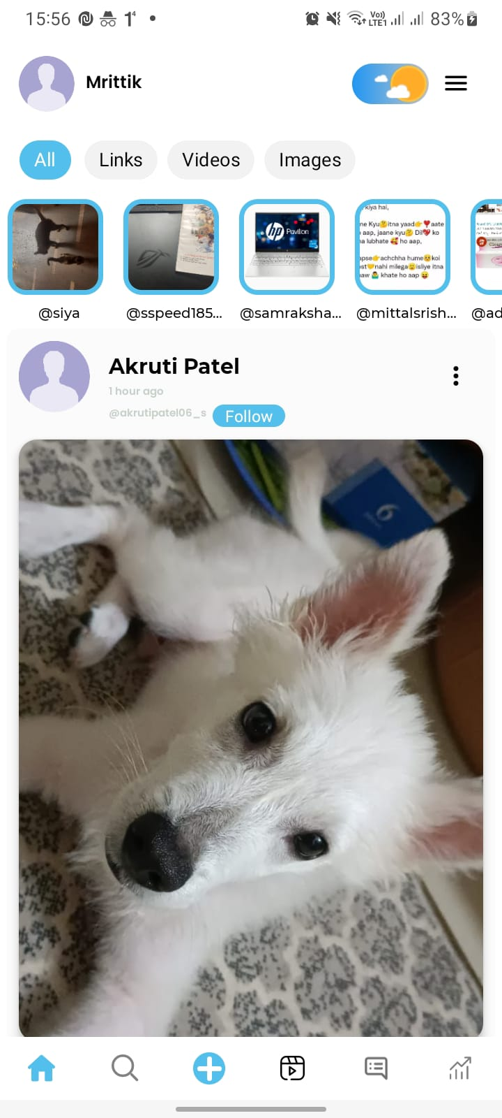
Need good UI/UX interface for app
App UI/UX is not upto the mark. Need changes in appreance

Slide 9
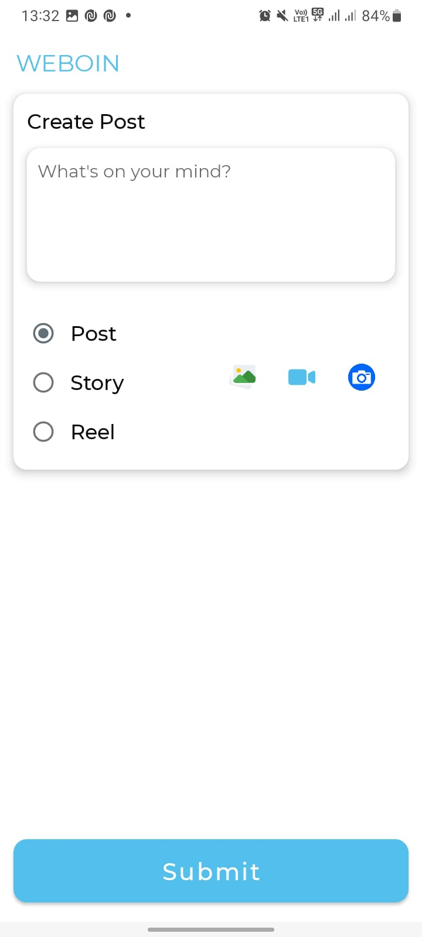
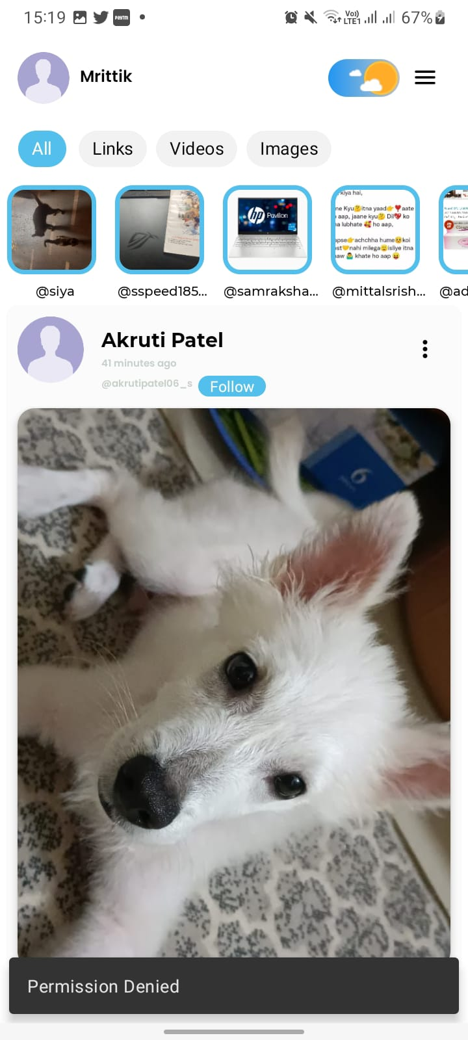
cannot post anything like pictures, videos
Cannot post anything

Slide 10
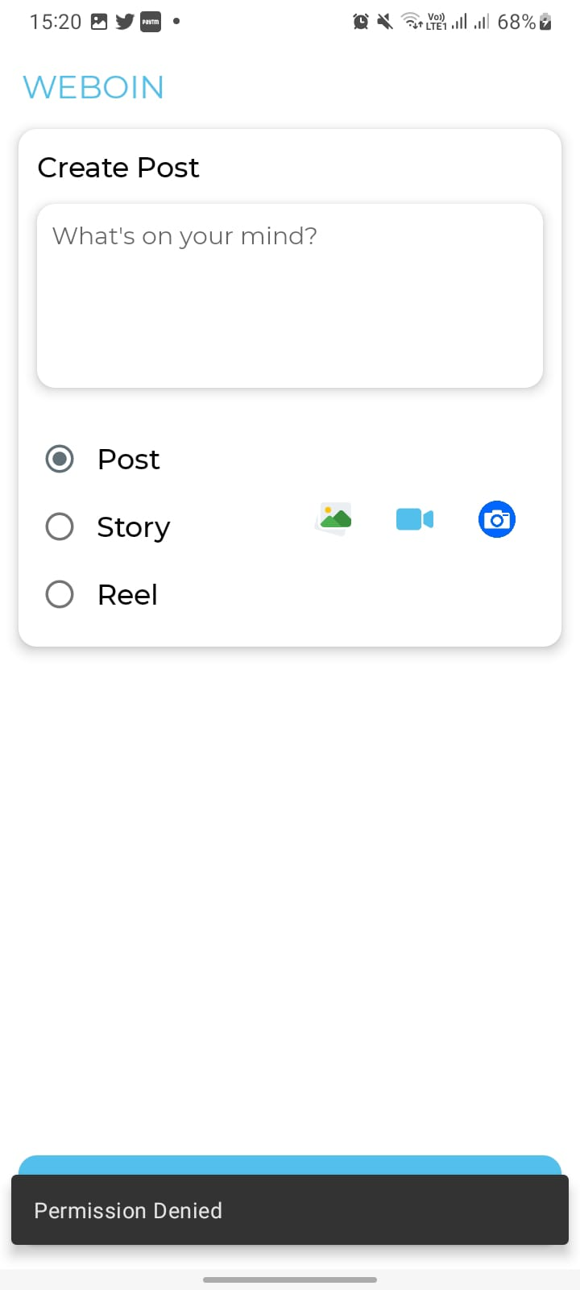
cannot access camera using the app
Cannot access camera in app also video feature doesnot work.

Slide 11
upon sending video , it doesnot show in message chats
The video I send doesnot open in chats.

Slide 12
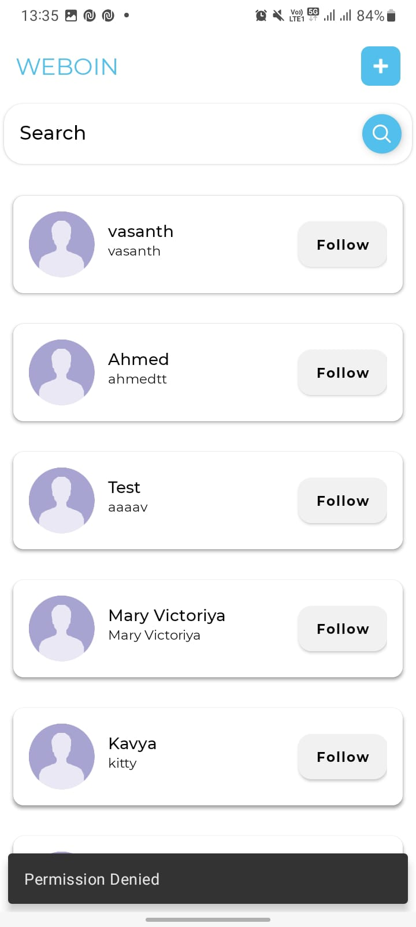
cannot access (+) button
The + buttion doesnot work in the app.

Slide 13
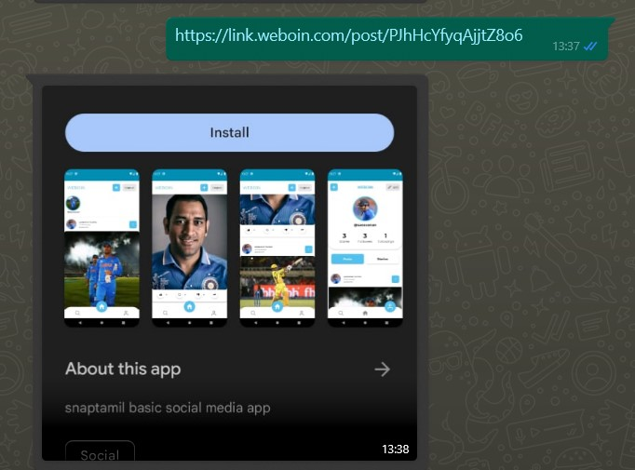
The reels shared by other social media platforms dosenot open in browser
When link shared through social platforms it doesnot get open in browser like other apps.

Slide 14
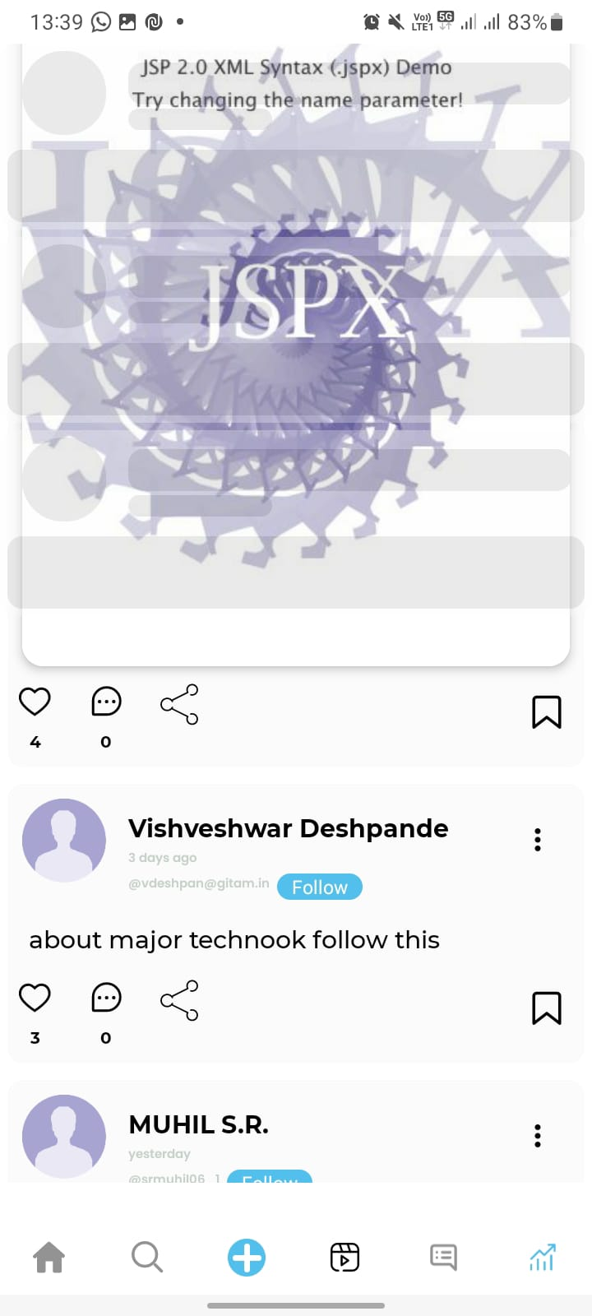
glitches in trending section
This layout overlaps in rest of remaining app.

Slide 15
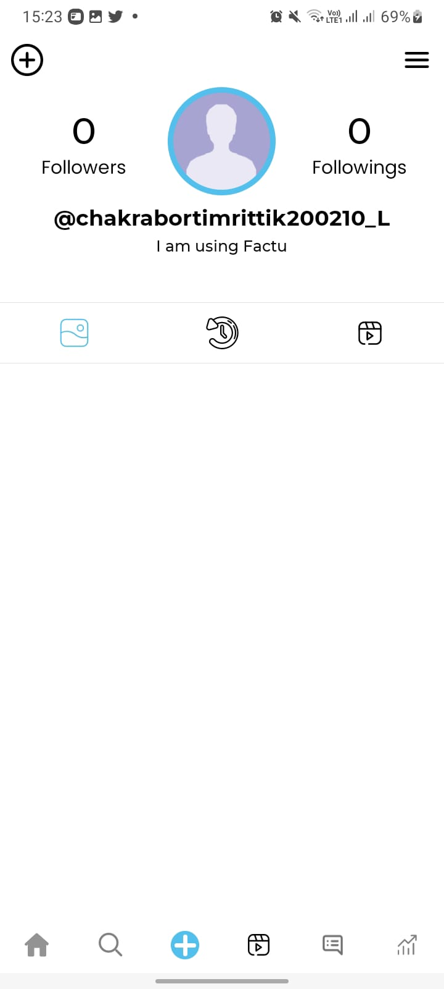
My photos and videos dont get stored to my account page
No pictures , videos shown which I shared

Slide 16

The app takes unnecessary time to load
App takes unecessary time to load depending upon network speed

